Slide 1


Slide 2
Code Kata
Become a Better Software Developer
Quinn Wilson / qwilson@obsglobal.com / @quinnwilson

Slide 3
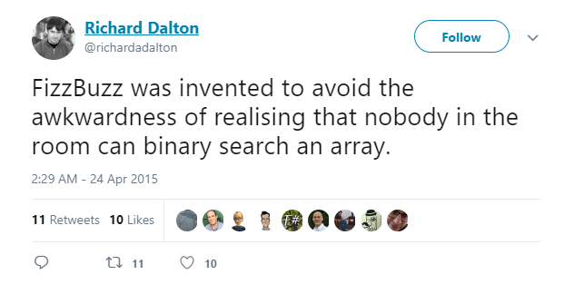

Slide 4
Agenda
About Me
Why this presentation
Motivation
Etymology
What is Code Kata
Deliberate Practice
Benefits, psychology and theory
Gamification
Social

Slide 5
About Me
Developer
Husband
Father

Slide 6
About Me
Lazy Developer
Lazy Husband
Lazy Father

Slide 7
About Me
Lazy Developer
Lazy Husband
Lazy Father
Lazy Presenter

Slide 8
Why this presentation?
Not doing anything about our own education
Not directing our education
Not getting results
Notes:
Simply - I wanted to share my experience with the Code Kata as a way to level up your skills
With Code Kata In the last three years I’ve been able to focus my learning and have learned 3 programming languages

Slide 9
Why is everyone in such a rush?
Notes:
“Teach Yourself XYZ in 24 hours”
Minimize the risk, maximize the reward?
Something about the value of education you’re getting

Slide 10
Why is everyone in such a rush?
Research has shown that expertise takes time
"Excellence in any department can be attained only by the labor of a lifetime; it is not to be purchased at a lesser price.” (Samuel Johnson (1709-1784))
Notes:
Outliers 90 minutes of practice a day for 20 years

Slide 11
Why is everyone in such a rush?
Research has shown that expertise takes time
Peter Norvigs “Teach Yourself Programming in Ten Years”
(Bloom (1985), Bryan & Harter (1899), Hayes (1989), Simmon & Chase (1973))
Notes:
Outliers 90 minutes of practice a day for 20 years

Slide 12
Why is everyone in such a rush?
Research has shown that expertise takes time
10,000 Hours (Malcom Gladwell(2008))
Notes:
Outliers 90 minutes of practice a day for 20 years

Slide 13
Why is everyone in such a rush?
Learn at least a half dozen programming languages.
Include one language that emphasizes class abstractions (like Java or C++),
one that emphasizes functional abstraction (like Lisp or ML or Haskell),
one that supports syntactic abstraction (like Lisp),
one that supports declarative specifications (like Prolog or C++ templates),
and one that emphasizes parallelism (like Clojure or Go).
-- Peter Norvig

Slide 14

Learning Resources
Subscription video tutorial site
Blog post
YouTube videos
Vendor docs
Books
Classroom teaching
Stack Overflow?

Slide 15
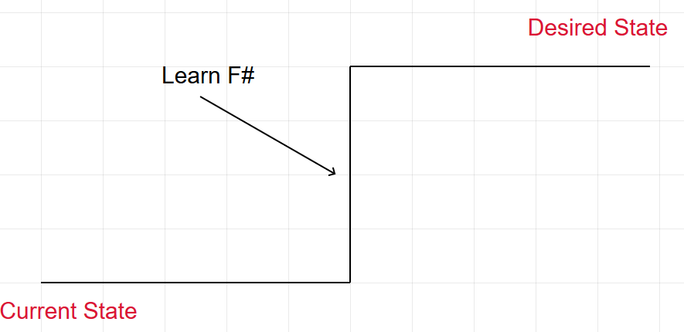
Moving Toward the Target Condition

Slide 16
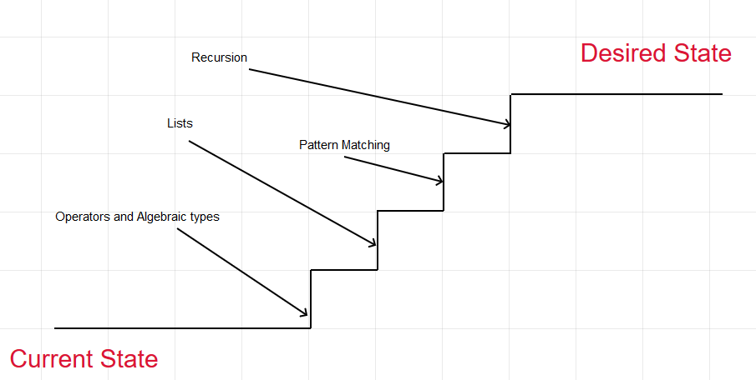
Moving Toward the Target Condition

Slide 17
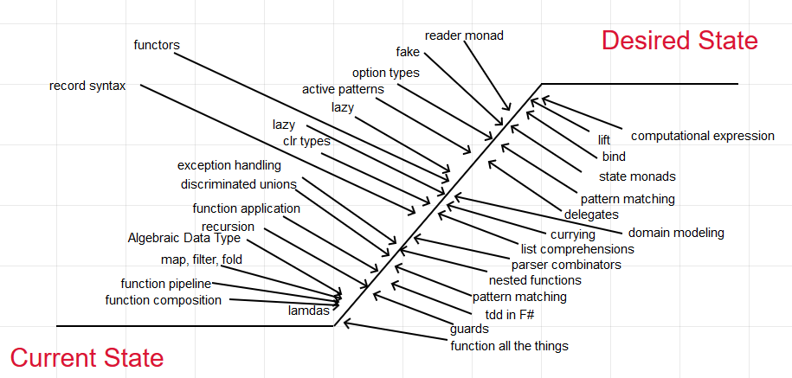
Moving Toward the Target Condition

Slide 18
DEV LIFE
Develop software with C#
Notes:
Why do I need practice? I spend 8 hours a day coding in c#?

Slide 19

DEV LIFE
Develop software with C#
Understanding User Stories
Source Control
IDE
meetings

Slide 20
DEV LIFE
Develop Software with C#
User Stories
Source Control
IDE
meetings
CSS
SQL
HTML
meetings
Build
Bug triage
More meetings
Deployments
Documentation
Manual Testing
Seriously? More meetings
Installing software
Rebooting
Bug tracking thing
Time tracking thing

Slide 21
DEV LIFE
Develop Software with C#
User Stories
Source Control
Cat pictures
IDE
Meetings
coffee
CSS
twitter
SQL
HTML
Meetings
YAML thing
Build
Googling error messages
Bug triage
Meetings
Deploy
Lunch planning
Documentation
Manual Testing
giphy
Stack Overflow
YAML thing
Seriously? More meetings
Installing software
coffee
Rebooting
Bug tracking thing
Time tracking thing
Meetings Kill me
Talk to DBA about access
Manual Testing
lunch
Reset password
Develop with javascript
Pre-meeting call
Slack
xkcd
Email
Talk about comic book movie
Quick coffee meeting
Listening to Chad complain
Submitting helpdesk ticket
YAML thing

Slide 22
Kata
from the Japanese
Kata (noun); lit. “form”
The word stems from basic forms of movement in martial arts, which are handed down from master to student over generations
A way of doing something; a method/routine
A pattern
A standard form of movement
A predefined, or choreographed sequence of movements

Slide 23
Kata
Karate kata are executed as a specified series of a variety of moves, with stepping and turning, while attempting to maintain perfect form.
The kata is not intended as a literal depiction of a mock fight, but as a display of transition and flow from one posture and movement to another, teaching the student proper form and position, and encouraging them to visualize different scenarios for the use of each motion and technique.

Slide 24

Kata

Slide 25
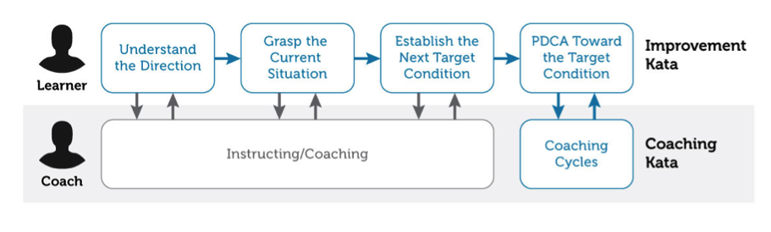
Kata
The Toyota Way
Improvement Kata (and the Coaching Kata)

Slide 26
Code Kata
The term was probably coined by Dave Thomas, co-author of the book The Pragmatic Programmer
Is an attempt to bring this element of practice to software development
Repeating a form many, many times, making little improvements in each
Implicitly encourages micro-experimentation
a fast feedback loop

Slide 27
Code Kata
The term was probably coined by Dave Thomas, co-author of the book The Pragmatic Programmer
Is an attempt to bring this element of practice to software development
Repeating a form many, many times, making little improvements in each
Implicitly encourages micro-experimentation
a fast feedback loop

Slide 28
Remember that the point of the kata is not arriving at a correct answer. The point is the stuff you learn along the way. The goal is the practice, not the solution.
Dave Thomas – codekata.com

Slide 29
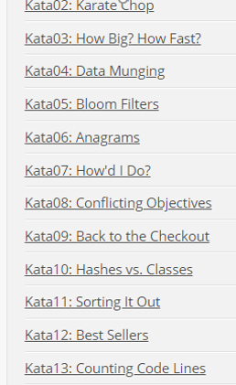
Code Kata

Slide 30
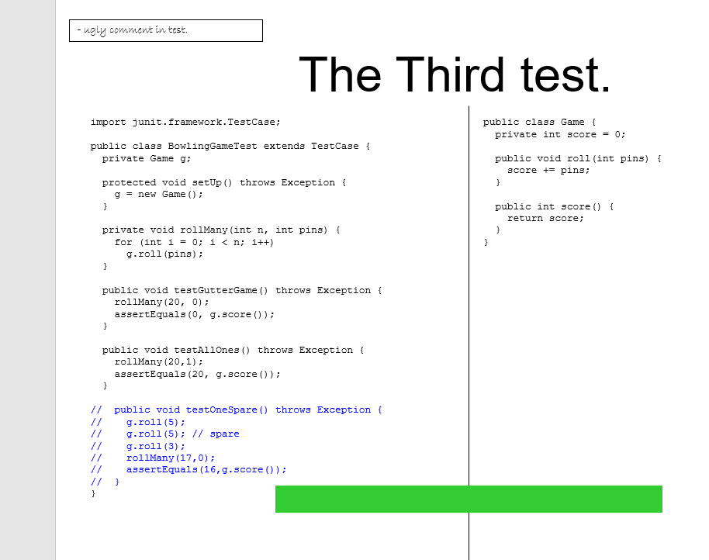
Code Kata
Robert (Uncle Bob) Martin “Bowling Game Kata”

Slide 31
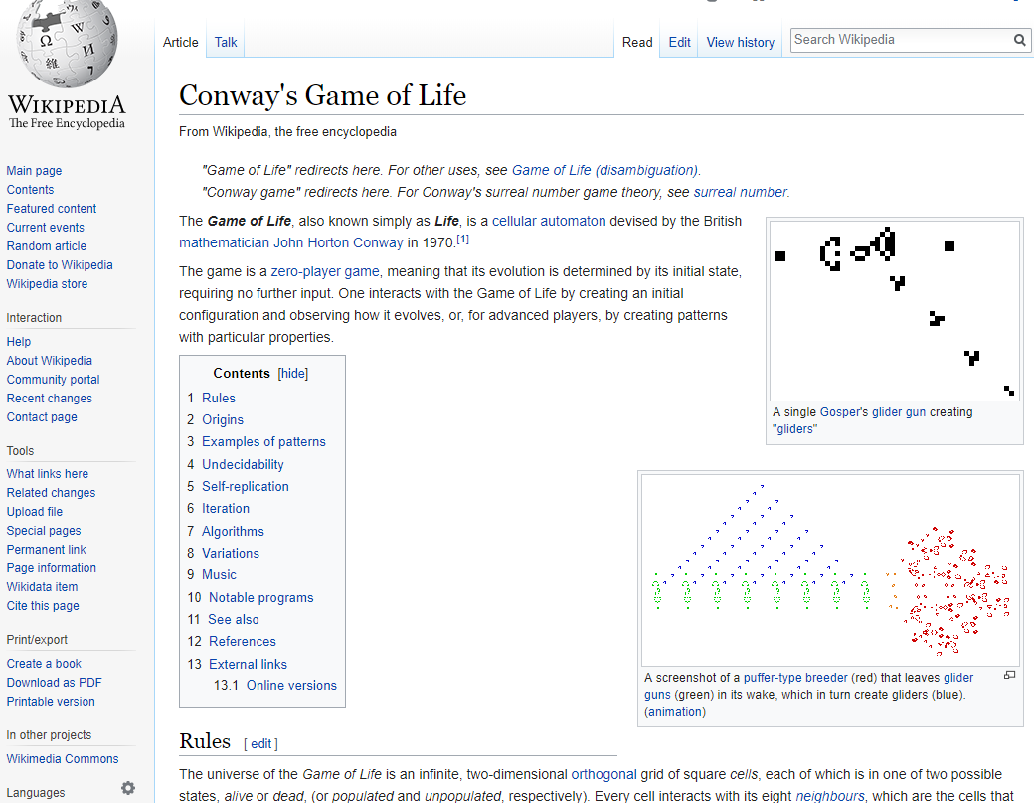
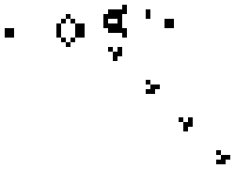
Code Kata
Global Day of Code “Conway’s Game of Life”

Slide 32
Code Kata
The Kata
Kumite
Koan
Dreyfus

Slide 33
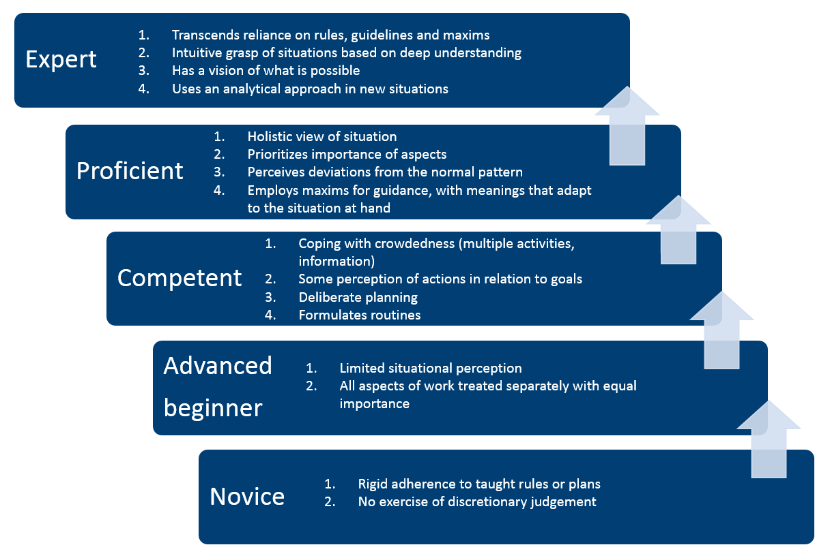
Code Kata

Slide 34
Kata – recap
Karate kata are executed as a specified series of a variety of moves, with stepping and turning, while attempting to maintain perfect form.
The kata is not intended as a literal depiction of a mock fight, but as a display of transition and flow from one posture and movement to another, teaching the student proper form and position, and encouraging them to visualize different scenarios for the use of each motion and technique.

Slide 35
Code Kata
Code kata are executed as a specified series of challenges which draw on different elements of software development, while attempting to “maintain perfect form”
The kata is not intended as a literal depiction of a mock business scenario, but as an exercise encouraging the learner to visualize different scenarios for the use of each strategy and technique.

Slide 36
Code Kata
Where do you practice?
Where do you fail?

Slide 37
Kata
“what matters is not experience per se but ‘effortful study,’ which entails continually tackling challenges that lie just beyond one's competence. ”
The Expert Mind – Mirsky 2006

Slide 38
Deliberate Practice
Project Euler
https://projecteuler.net
free
617 programming/mathematical problems
The problems range in difficulty and for many the experience is inductive chain learning. That is, by solving one problem it will expose you to a new concept that allows you to undertake a previously inaccessible problem. So the determined participant will slowly but surely work his/her way through every problem.
Notes:
Oiler

Slide 39
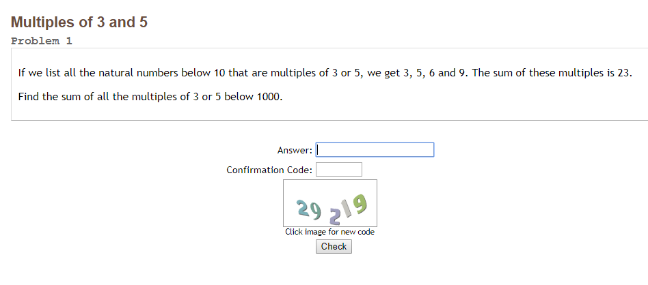
Deliberate Practice

Slide 40
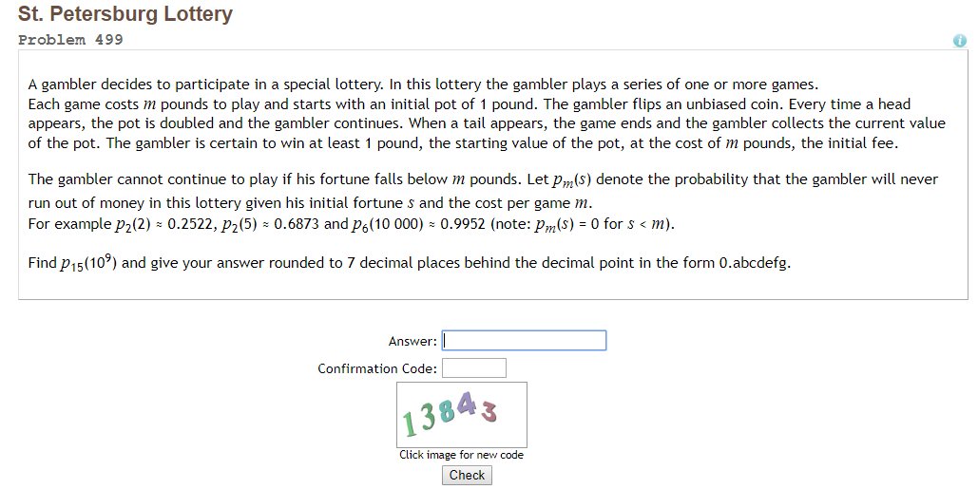
Deliberate Practice

Slide 41
Deliberate Practice
Code Wars
https://www.codewars.com/
Free
In browser
Multiple (> 20) programming languages
Most come with canned unit tests
Leveled – with a pathway from beginner to expert
Clans - competition
Gamefication

Slide 42
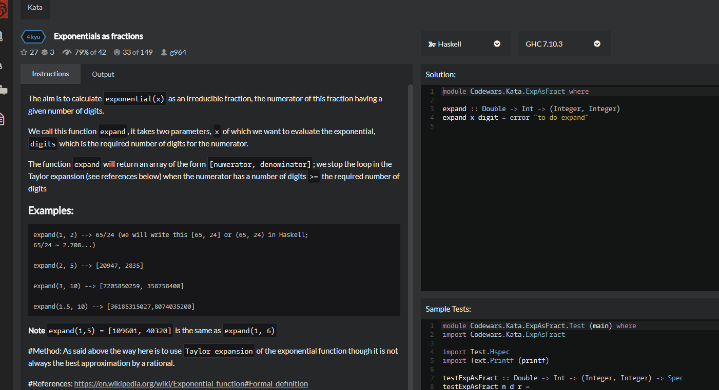

Slide 43
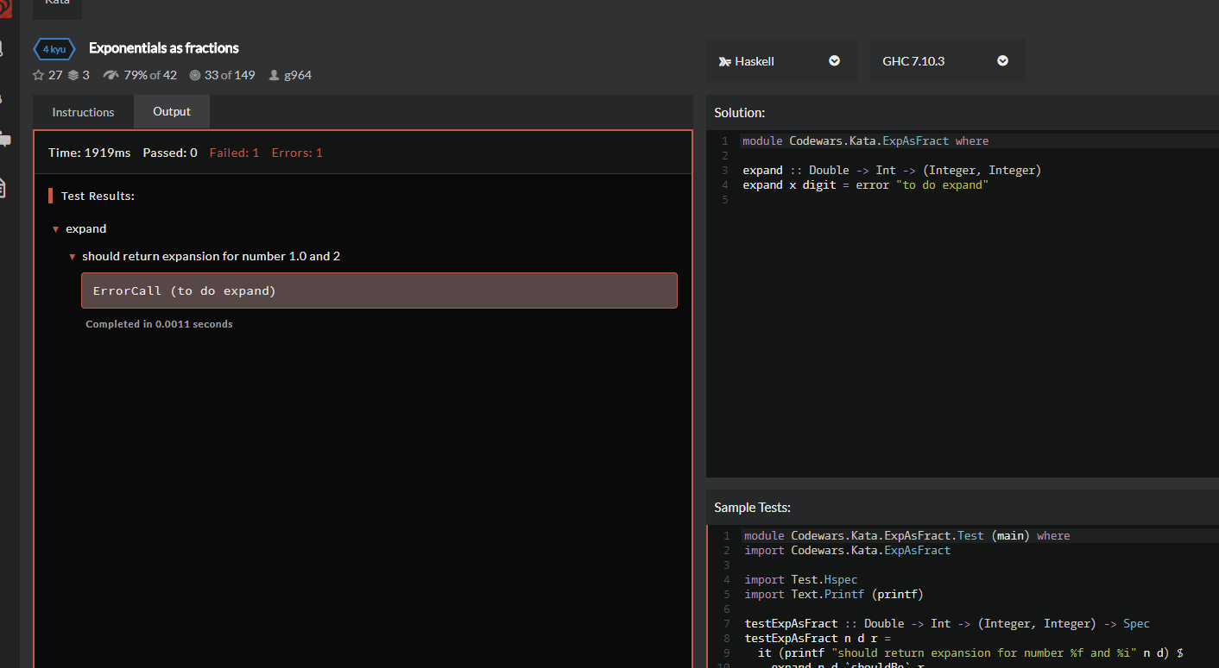

Slide 44
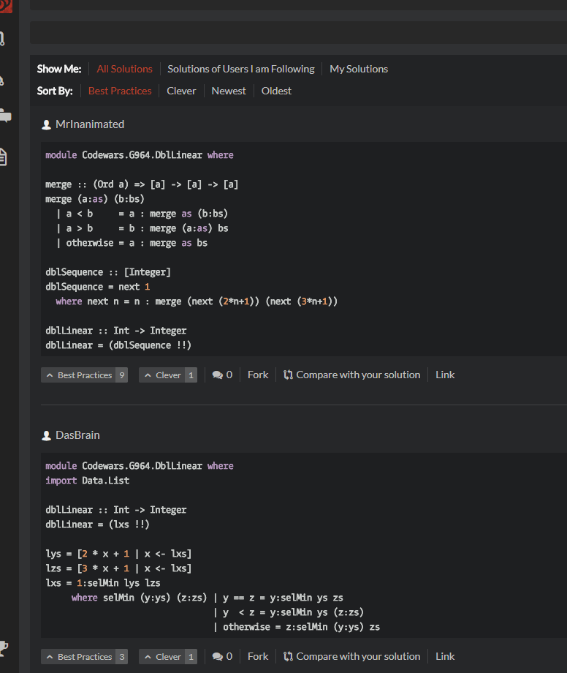

Slide 45
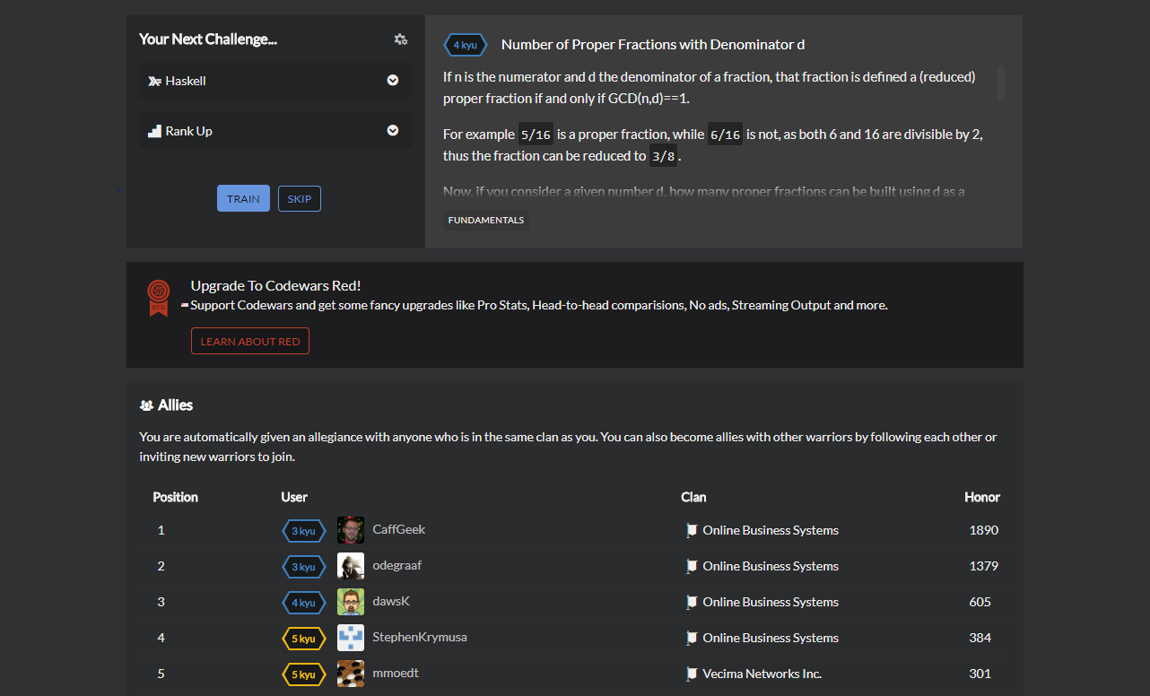

Slide 46
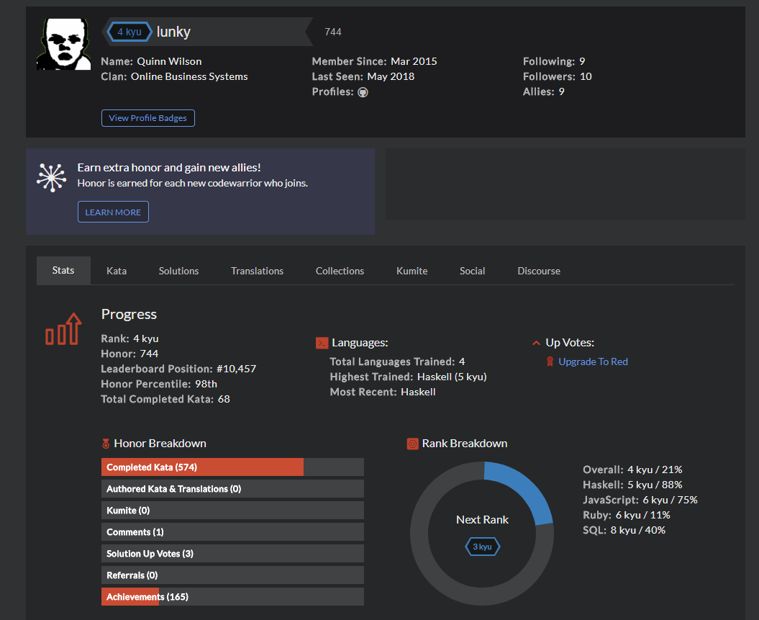

Slide 47
Deliberate Practice
https://coderbyte.com
https://codefights.com/
https://www.codingame.com/
https://www.topcoder.com
https://www.hackerrank.com/
99 Problems (Haskell, Lisp, Prolog…)
https://adventofcode.com/
… many more
Notes:
Coderbyte – not as nice an editor
Topcoder and Codefights are more like recruiting tools

Slide 48
Code Kata
“…So, my challenge for the day: see if you can carve out 45 to 60 minutes to play with a small piece of code. You don’t necessarily have to look at performance: perhaps you could play with the structure, or the memory use, or the interface. In the end it doesn’t matter. Experiment, measure, improve.
Practice.”
Dave Thomas codekata.com

Slide 49
Moving Toward the Target Condition

Slide 50
Moving Toward the Target Condition

Slide 51
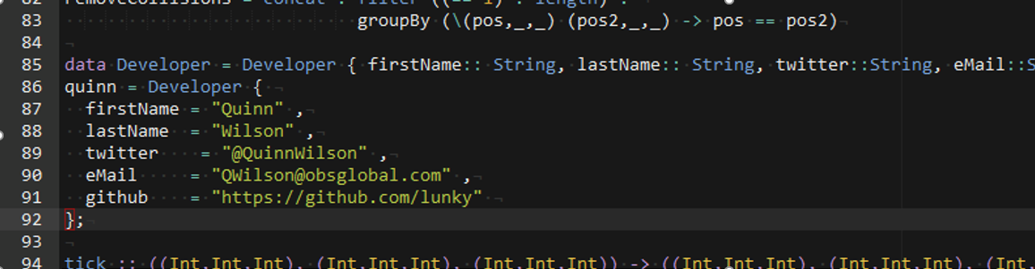
Contact Me

